Slide 1
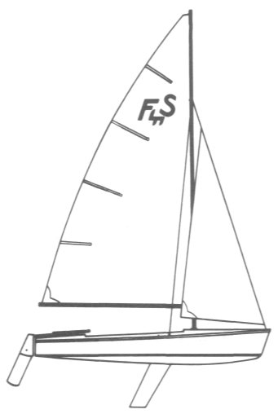
Crew Development Seminar
Mentoring Skippers and Crew
Dave Beckett

Slide 2
What Are We Going to Talk About?
How to be great crew
Knowledge and skills
Sailing the boat
Expectations
The skipper as mentor

Slide 3
Sail With Skippers Who:
Are competent – You want to learn
Safe – You want to come back
Don’t yell – You want to have fun
These are important constants whether you’re day sailing, racing, or cruising on the ocean.

Slide 4
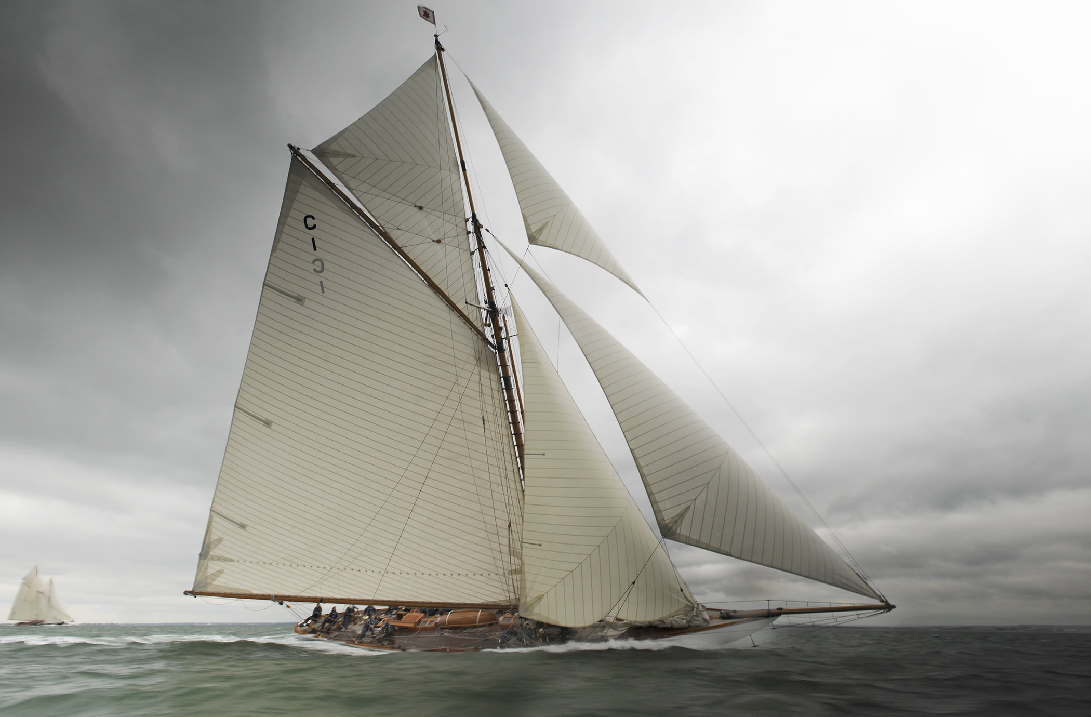
Important Attributes for Crew

Slide 5
Important Attributes for Crew
Positive attitude
Knowledge
Performance

Slide 6
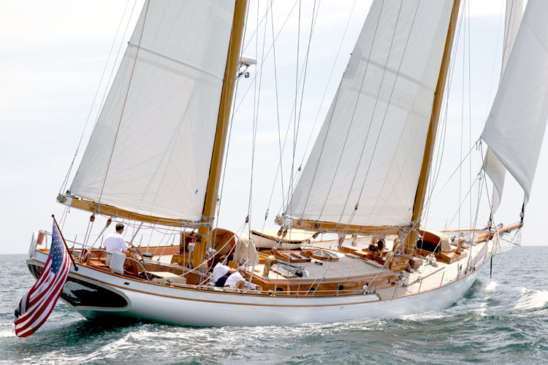

Slide 7
Positive Attitude
On time
Not lazy
Eager to learn
Attentive

Slide 8
Positive Attitude
Responsive
Proactive
Flexible
Resilient/Perseverant
Good communication skills

Slide 9
Knowledge
Read on your own
Reinforce on the water
Ask questions

Slide 10
Performance
Do your best
Expect to make mistakes Stuff happens
Adapt and overcome Deal with it
Be receptive to instruction and constructive input

Slide 11
What Do You Need to Know?

Slide 12
Rule # 1: Skipper Is in Charge
There’s only one skipper
Ok to ask the skipper questions
Not ok to question/second guess the skipper
Crew must defer to the skipper for decisions regarding operating the boat
Exceptions: Safety or ethics or law when you know you are right

Slide 13
Things to Do
Pay attention
Anticipate
Do what your told
Ask questions if you don’t understand
Have fun

Slide 14
Things Not to Do
Don’t argue with your skipper.
It’s ok to discuss strategies or options, but when the skipper gives a command, obey it and do your best.

Slide 15
What to Know
Parts of the boat – Rigging and controls and their function
Basic sailing theory – Know a little about what makes the boat go.
Rules of the road – Basic understanding

Slide 16
What Knots to Know
Bowline – the one to know if you only know one
Figure Eight
Reef knot/square knot
Cleat hitch
Clove hitch
Practice tying these knots until you are confident that you can tie them quickly under stress.

Slide 17
Sailing Fundamentals for Crew

Slide 18
What Makes a Sailboat Go Basic Aerodynamics

Slide 19
What Makes a Sailboat Go Forces Acting on a Sail

Slide 20
Points of Sail

Slide 21
Upwind

Slide 22
Tacking

Slide 23
Downwind

Slide 24
Jibing/Gybing

Slide 25
Basic Parts of a Sailboat

Slide 26
Parts of a Flying Scot

Slide 27
Safety Items Keep Clear of the Following
Boom – most dangerous thing on the boat
Centerboard rollers
Cleats and blocks

Slide 28
Safety Items Keep Clear of the Following
Lines under tension
Booms of other boats
Crushing hazards – boats, piers, pilings (Keep extremities inside boat)

Slide 29
Boom Vang, Outhaul & Winch Box

Slide 30
Centerboard and Rollers and Cleat

Slide 31
Safety Items
Be aware of the following
Wind speed
Air temp
Water temp
Vessel traffic
Changing conditions

Slide 32
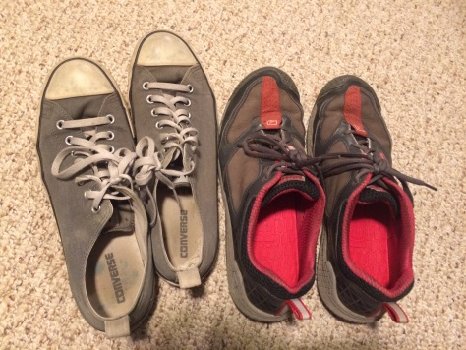
What Should You Bring
In the beginning:
Sunscreen – zinc/titanium oxide physical block
Sunglasses (polarized) – that you can afford to lose
Proper footwear – non-marking athletic shoe
Converse Chuck Taylor ($26) – great for FS sailing
Sperry ($50-$130)

Slide 33
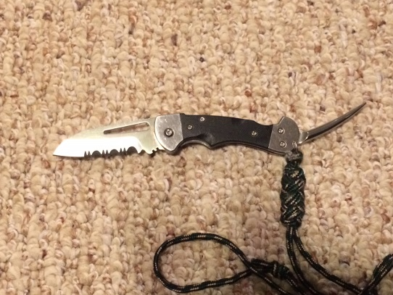
What Should You Bring
After you get into it:
Winch handle ($7-$11) – keep it in your PFD or pocket
Sailing Gloves ($25-$45) – not necessary but protect hands; wear them if you race
Riggers knife/folding knife ($30-$100) – keep on your body

Slide 34
Actions/Behaviors of Effective Crew

Slide 35
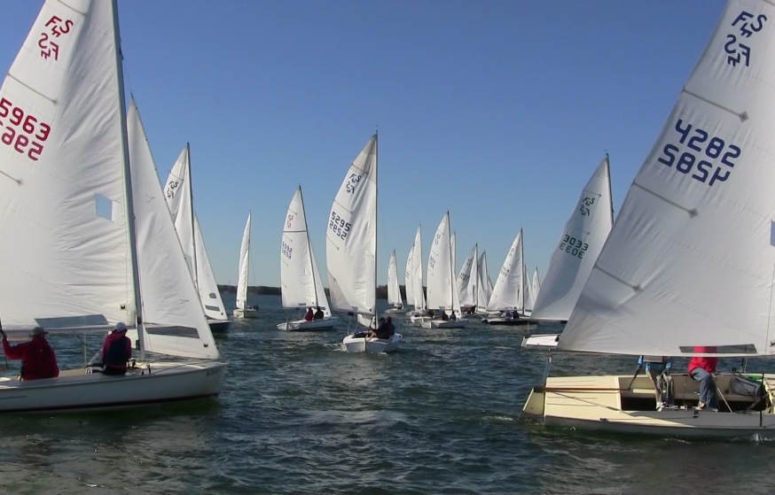
Lookout – Observe and Report
Hazards to navigation
Nav-aids: buoys/day marks
Wind: gusts, lulls, shifts
Current
Boats and shipping
Relative Bearing
Range
Tack for sailing vessels/approximate course for MV
Rules situation: overtaking, crossing, CBDR, etc.
Weather and other environmental conditions
CBDR = Constant Bearing, Decreasing Range = Risk of collision

Slide 36
Safety Observer - Observe and Report
Any unsafe condition
Rigging or equipment malfunction or damage
Fouled running rigging
Wingtip Vortex
Everybody onboard is a safety observer

Slide 37
Monitor Boat Performance Don’t Be a Robot
Trim and balance
Speed
Heading
Any sudden or subtle changes that could indicate grounding or damage
Rudder and centerboard status; up or down
Anticipate and always be ready to raise centerboard on command

Slide 38
Quick Reactions to Help Avoid Disaster

Slide 39
Attentive Crew Can Save the Day
Boom Vang: Be ready to quickly ease the boom vang when heading downwind (bearing away to duck a starboard tack boat)
Centerboard:
Be ready to quickly raise the centerboard to clear shoals or anchor lines
Make sure it’s down when it’s time to go upwind
Attentive crew can be the decisive factor in avoiding disasters like collisions or penalties.

Slide 40
Immediate Actions Upon Grounding
Tack
Raise centerboard (CB) to decrease draft (half way or as far as necessary)
Tack immediately into deeper water while you have momentum
Back jib to help swing the bow
CB down just enough to aid in tacking/steering
Sail into fair water and ease CB down
If not enough momentum to tack or if boat fails to tack:
Jibe
Centerboard all the way up
Bear away and jibe: use sail trim to help turn boat
Sheet in on jib/over trim or back if necessary
Ease mainsheet
Use crew weight to turn and also heel the boat if needed
Sail into fair water and ease CB down

Slide 41
Communicator
Communicate useful and critical info to skipper in a timely manner
Don’t overload the skipper with superfluous or useless information
Be prepared to use the vhf radio to communicate with other boats. Be familiar with proper R/T procedures.

Slide 42
Odd Jobs
Bailer
Knot untier and line unfouler
Temporary helmsman
Finder of lost things

Slide 43
Getting Underway
Follow the skipper’s directions
Watch your skipper’s back
Keep the bow into the wind until directed otherwise
Don’t do anything that results in sails filling before the skipper directs you
Be observant of traffic and other hazards during the departure and approach

Slide 44
Docking
Be prepared to do the following with little or no warning:
Exactly what you’re told
Exact opposite of what you were previously told
Somewhere in between
During approach to dock, don’t automatically jump up on the bow in an effort to be helpful. Only step onto the bow if directed by skipper.

Slide 45
Docking With a Catch

Slide 46
Sailing The Boat

Slide 47
Trimming the Jib – Be Proactive
Un-cleat jib sheets prior to tacking
Don’t let the jib flog or luff excessively
Back the jib in light or choppy conditions to assist the helmsman during tacking
Sail handling and steering – Use jib/main trim to help steer in close quarters

Slide 48
Tacking – Jib Trim
Before Tack Uncleat jib sheets
During Tack Take out the slack
After Tack Shape and trim
Don’t crush shape

Slide 49
Flying Scots Sail Better Flat Easier to Sail and Faster
Reducing heel
Increases forward motion
Reduces leeway
Reduces weather helm
To keep the boat flat, anticipate puffs
Ease
Hike
Trim

Slide 50
Special Stuff
Hydrilla
Towing
Risk Assessment
Conflict Resolution

Slide 51
Hydrilla
Location
Avoidance
How to minimize fouling
Centerboard up
Induce heel
Tack early
Reach with speed to cut through
How to clear foils
Cycle centerboard
Rudder – clear by hand or boathook

Slide 52
Towing
Passing/receiving towline
Rigging
Astern or alongside
Bow eye
Boat handling
Speed
Maneuverability
Centerboard
Keep everything clear of props

Slide 53
Risk Assessment
Weather conditions and forecast
Environmental factors
Daylight
Hydrilla
Tide
River Flow Rate – rain induced current
Water Temp
Boat characteristics
Operation to be conducted
Skipper and crew capabilities: skill/experience

Slide 54
Conflict Resolution
In conflict with your skipper?
You’re in the wrong place
Get through the day
Find another boat
If you think you know enough to argue with your skipper:
Stop wasting your time
Get skipper certified and skipper your own boat

Slide 55
Spinnakers The Devil’s Playground

Slide 56
Spinnaker Advice
Run the tapes
Double check the rigging
Douse early (stowed at 3 BL zone)
No stopper knots on spinnaker sheets. Why?

Slide 57
To Avoid This

Slide 58
Race Considerations

Slide 59
General
Extra set of eyes and ears for skipper
Double check fittings/rigging, lines, and sails
Track tides, wind, current, course, RC signals
Observe/report effects on laylines, mark roundings, start/finish line
Learn basic RRS; help skipper anticipate tactical situations

Slide 60
Jib Trimmer
Continuously monitor & adjust trim and shape
Windward sheeting
Don’t over trim coming out of tacks and mark roundings – keep some shape to accelerate
Back jib during tacks to help turn boat if needed

Slide 61
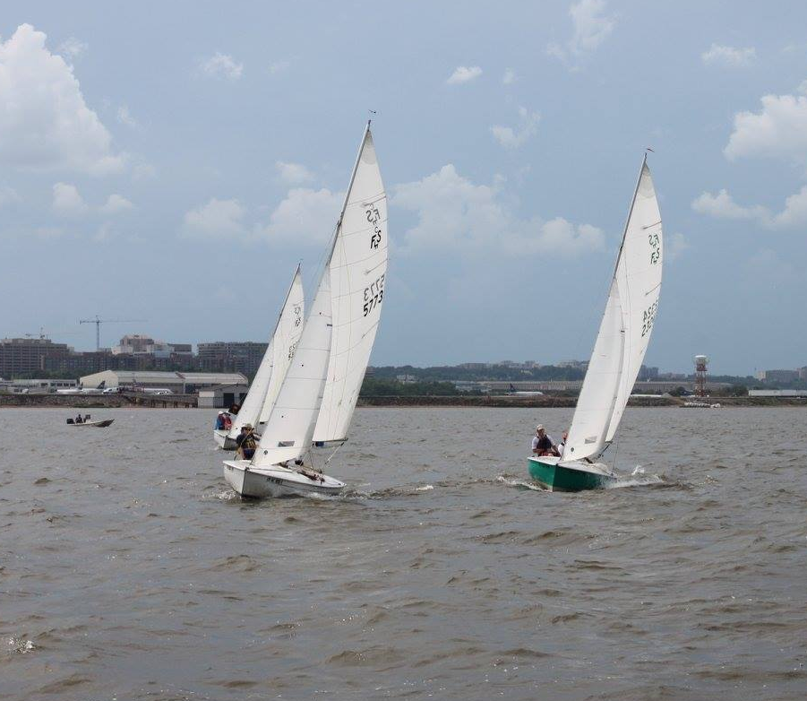
After the Start Who’s Doing What?
Relative heading and speed of other relevant boats (sailing angle/speed)
Higher and faster
Higher and slower
Lower and faster
Lower and slower
Same – same

Slide 62
What to Report
Anticipate, Observe and Report Wind
Gusts, lulls, and shifts (lifts and headers)
Automatically ease, hike, trim
Automatically adjust weight in boat as needed
Identify Oscillating and Persistent Shifts
Call out wakes and chop, debris and hydrilla

Slide 63
What to Think About
Identify the course
Keep track of where you are on the course
Which mark?
Which lap?
Always locate the next mark
Assist in calling layline: account for all factors
Current
Wind shifts
Traffic

Slide 64
Spinnaker Rigging
Run the tapes
Spinnaker sheets go outboard of everything
Double check the rigging
Halyard
Sheet/guy
Topping lift
Downhaul
Never put stopper knots on spinnaker sheets. Why?

Slide 65
Spinnaker Hoist/Set
It’s ok to hoist first and then set pole
Prior to hoist, ensure halyard and sheets are free to run
After hoist, make sure guy is in twing/tweaker/guy clip and the sheet is free

Slide 66
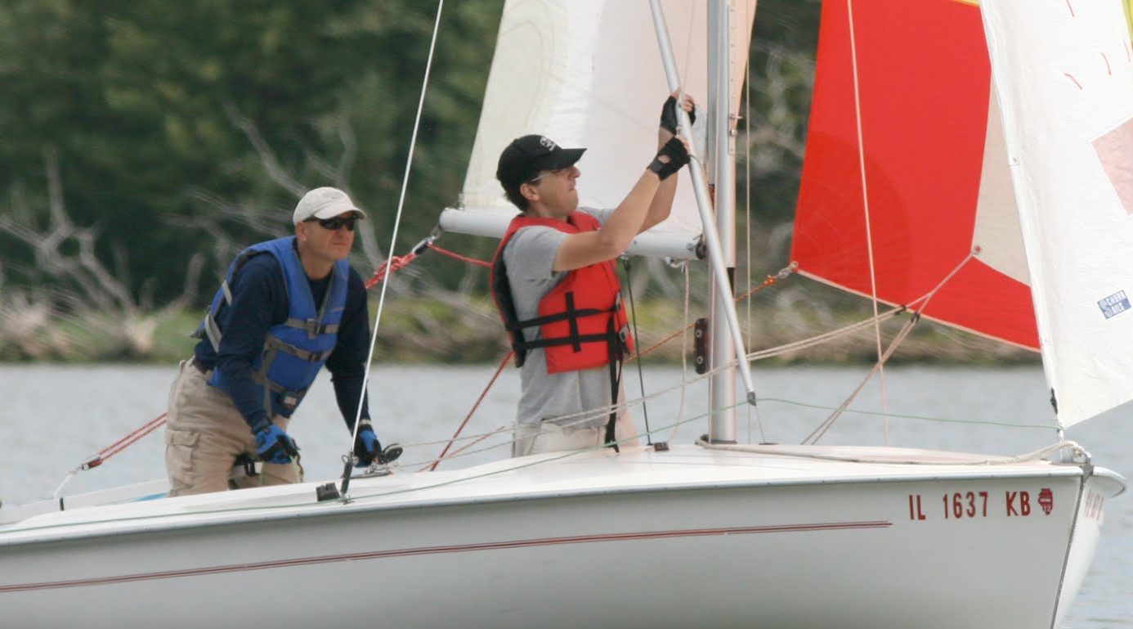
Spinnaker Hoist/Set
Clear communication on set: Port or Starboard
Be careful and deliberate when setting pole
Set in this order:
Guy (outboard end)
Topping lift
Mast (inboard end)
Spinnaker goes out and comes back in under jib sheet during hoist and recovery

Slide 67
Guy, Topping Lift, Mast
2
3
1

Slide 68
Spinnaker Douse/Takedown
Takedown and stowed before 3 BL zone. Remember to secure the halyard.
Be ready to hike out immediately as you round the leeward mark. Don’t oversheet jib.
Ask for earlier takedown if you are not getting things stowed in time.

Slide 69
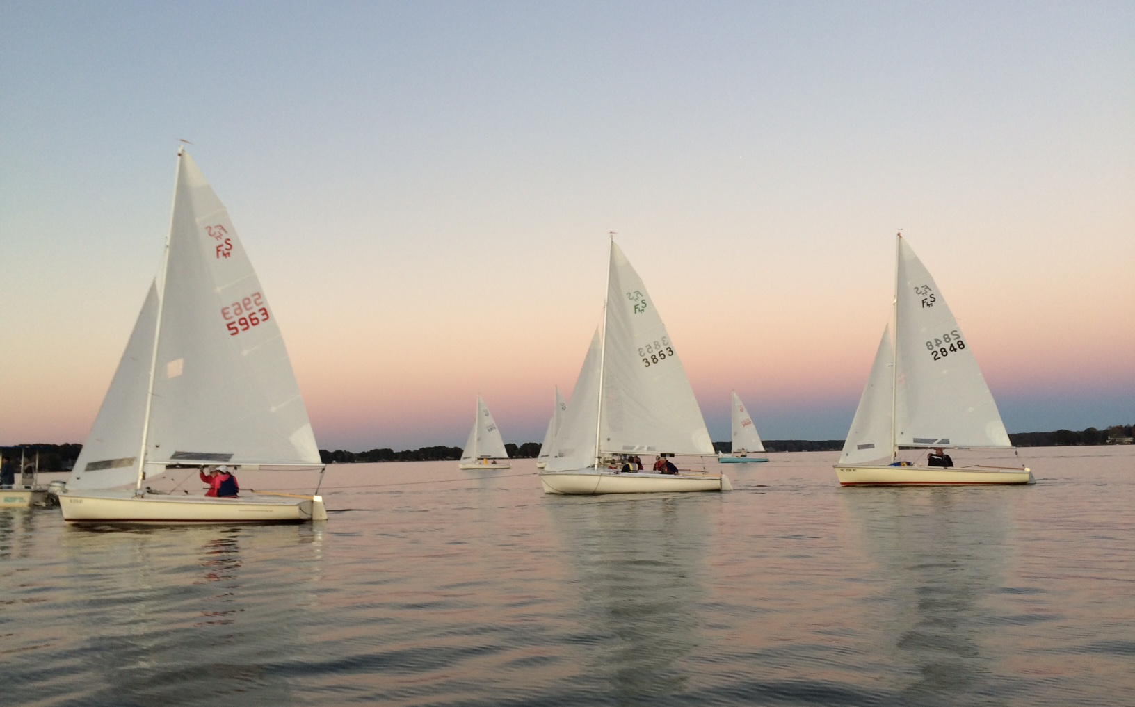
Expectations

Slide 70
Expect to:
Have fun
Learn
Be mentored to some degree by your skipper
Make a positive contribution even if only in small things

Slide 71
Expectations
Expect some things to go wrong – they will
Don’t expect to get yelled at – but you might
Yelling boats aren’t fun – find another boat
Yelling boats don’t win – find another boat

Slide 72
Skipper Leadership

Slide 73
Skipper – Leadership A ship has but one Captain
You are in charge and ultimately accountable
Take care of your crew and the boat
Eliminate and/or point out hazards
Your actions affect crew safety and comfort

Slide 74
Skipper – Leadership
Keys to success
Knowledge – Study and Experience
Skill and boat handling – PRACTICE
Poise – Stuff will go wrong. How you handle it affects the outcome.

Slide 75
Skipper – Leadership
Mentor your crew
Be willing to learn from more knowledgeable crew
Admit mistakes
Don’t yell

Slide 76
Mentor Your Crew - Progressively
Let them drive in low stress situations in open water, well clear of:
Shoals
Buoys and daymarks
Vessel traffic
Piers and obstructions
Practice docking on buoys in open water

Slide 77
Let them concentrate on steering only, initially, and not worry about sail trim
Goals should be getting a feel for:
Wind direction and points of sail
Being in the groove
Skipper maintain positive control of mainsheet
Position yourself
Out of the way
Close enough to react

Slide 78
Coaching Tips
Don’t over coach
Give direction in terms of where you want the bow to go, not what they should do with the tiller. Let them intuitively figure out the tiller.

Slide 79
Get Out There

Slide 80
Back Up Slides

Slide 81
Proper Radio Telephone Procedures
Sailing Club of Washington
Dave Beckett
Vice Commodore
Adapted from
CGTTP 6-01.1A Radiotelephone Handbook

Slide 82
Transmitting
Check settings and verify the proper frequency/channel is dialed in.
Listen carefully to ensure no other transmissions are in progress.
Speak clearly in normal tone of voice and hold microphone about two inches from your mouth.

Slide 83
Transmitting Guidelines
Avoid excessive calling and unnecessary transmissions. Transmit call signs only once when radio conditions are favorable.
After three unsuccessful attempts to contact a station, transmit the proword NOTHING HEARD. Establish communications with another station and request assistance in contacting the original unit. Continue contact attempts at reasonable intervals.

Slide 84
Transmitting Guidelines
Brevity
Professional
Concise
Clear
It’s not a cell phone
Don’t sound like an idiot – the world is listening and it reflects on you and the club

Slide 85
End Transmissions With Appropriate Prowords
Proword Meaning
OVER Recipient response required
OUT No response required
WAIT Use for pauses that require only a few seconds
WAIT OUT Use for pauses that require more than a few seconds

Slide 86
Proper Transmitting
(CALL SIGN) - THIS IS (CALL SIGN) - (ANNOUNCE TRAFFIC) - OVER
(CALL SIGN) - THIS IS (CALL SIGN) - OVER
If you make a transmission error, transmit the proword CORRECTION followed by the last word, group, proword, or phrase that was correctly sent.

Slide 87
Example R/T Conversation
Selkie – THIS IS Sunset Song – OVER
Sunset Song – THIS IS Selkie – OVER
Selkie – THIS IS Sunset Song. Request you rendezvous vicinity Buoy HP at 1500 – OVER.
Sunset Song – THIS IS Selkie – Roger – OVER
THIS IS Sunset Song – OUT

Slide 88
If You Missed Something
Sunset Song – THIS IS Selkie – Request you say again – OVER
Selkie – THIS IS Sunset Song – I SAY AGAIN… - OVER

Slide 89
If You Missed Something After Certain Point
Sunset Song – THIS IS Selkie – Request you say again ALL AFTER xyz (the last word you understood) – OVER
Selkie – THIS IS Sunset Song – I SAY AGAIN ALL AFTER xyz… – OVER

Slide 90
MAYDAY
A distress signal indicating a ship, aircraft, or other vehicle is threatened by grave and imminent danger, and requires immediate assistance.

Slide 91
If You Hear a MAYDAY Call
All stations hearing a distress call shall immediately cease transmissions that might interfere with the distress traffic and shall continue to monitor the frequency on which the call was heard until satisfied that assistance is being rendered.

Slide 92
Information for MAYDAY Call
“Mayday – Mayday – Mayday”
“THIS IS”
Distressed units name (three times)
Position
Number of persons on board (POB)
Nature of distress
Type of assistance required
Description of vessel

Slide 93
Example MAYDAY Transmission
MAYDAY (three times) - THIS IS SWAMPER (three times) - I'M A 46 FOOT CABIN CRUISER, WHITE HULL WITH BLUE TRIM - MY POSITION IS TWO MILES 126 DEGREES TRUE FROM WINDY POINT - THREE PERSONS ONBOARD - I LOST POWER AND THE SEAS ARE GETTING ROUGH - REQUEST ASSISTANCE – OVER

Slide 94
PAN - PAN
An urgency signal indicating the calling station has an urgent message to transmit about the safety of a ship, aircraft or other vehicle, or the safety of a person. Pronounced “PAHN-PAHN.”

Slide 95
Example PAN – PAN Transmission
Preliminary Announcement (use channel 16/2182 kHz): PAHN-PAHN (three times) - ALL STATIONS (three times) - THIS IS (voice call sign three times) - BREAK - (brief identifying data) - LISTEN (working channel frequency) - OUT

